Slide 1
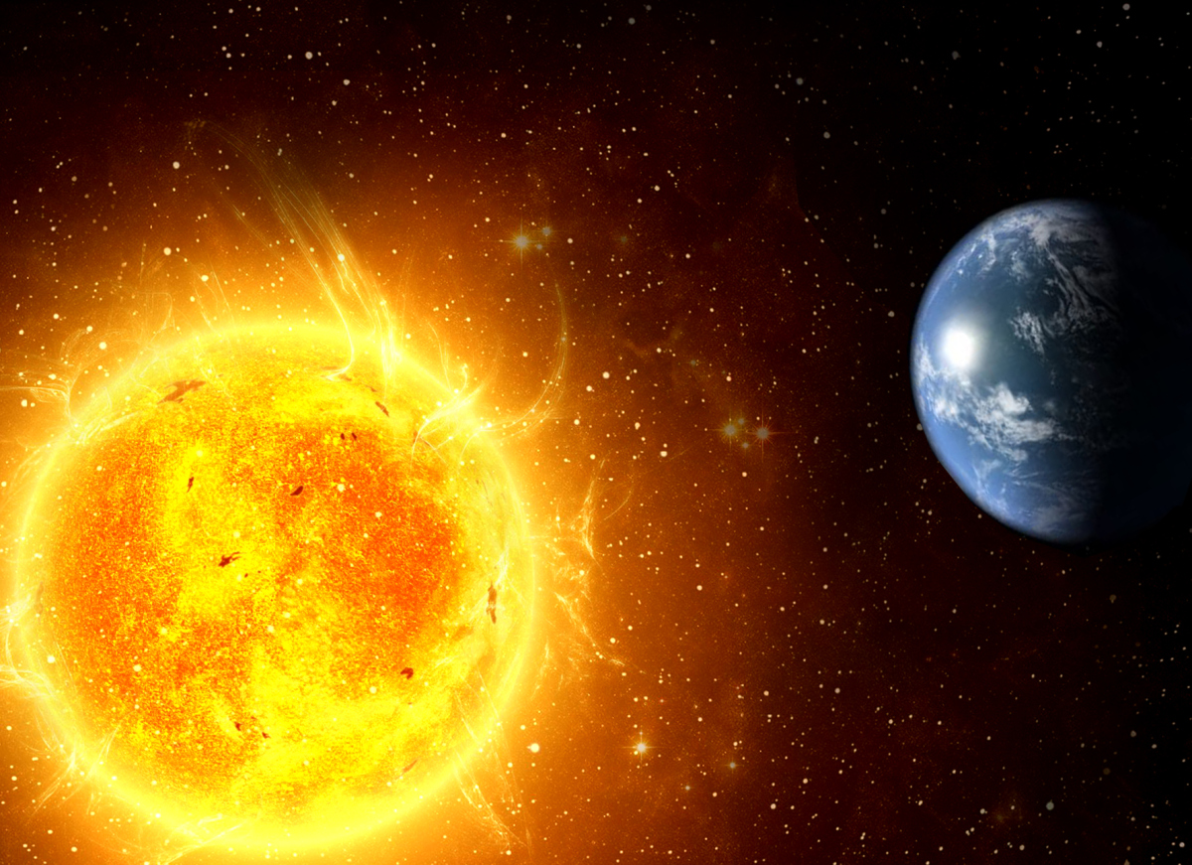
Science Energy Project
By Gabriel Veljanovski

Slide 2
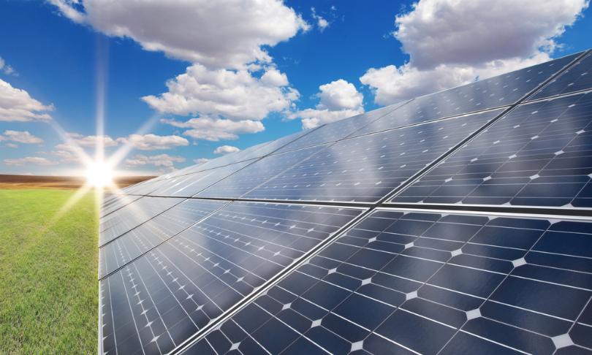
Solar Panels
A panel intended to absorb the sun's beams for creating power or warming. Solar panels are a highly efficient way to store and use energy.

Slide 3
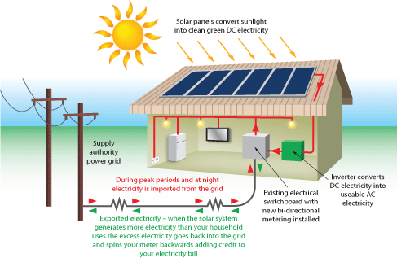
What is the source of your renewable energy?
The source of my renewable energy is the the sun. Solar panels work by allowing photons or particles of light, to knock electrons free of atoms generating a flow of electricity which can be converted into heat, light, ect.

Slide 4
What infrastructure is needed to convert the renewable energy into electrical energy?
Photo-voltaic solar panels
Travels to an inverter
Travels to the electrical service panel
Then passes through a tracking meter
Then into the house ready to be used.

Slide 5
What is the cost of building such infrastructure?
The cost to install a photo-voltaic solar panel system is $3799
Sometimes you can get government subsidy e.g.
$1116
Total to pay is
$2683
If you generate more electricity than you need
you can feed it back into the grid and receive credits or an income. The money you earn could cover your initially outlay.

Slide 6
Brown coal
What is brown coal:
Coal is formed when plant material is subjected to high temperatures and weights enduring a large number of years. There are different stages of the making of coal, such as:
Plant material/wood
Peat
Brown coal
Black coal
How is brown coal used to generate electricity:
Brown coal is pulverized and then burned in large-scale boilers. The heat is used to boil water and the steam is used to drive turbines that generate electricity. Brown coal forms the basis for 92% of electricity generation in Victoria.

Slide 7
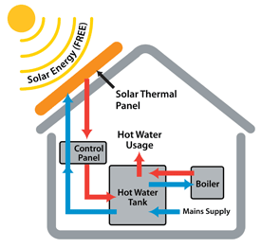
Brown coal versus Solar panels
Solar panels
Brown coal
Coal is burnt in power stations to generate electricity. Brown coal is crushed up to made a powder so it can burn more quickly. The coal is burnt at a temperature of around 1100 degrees Celsius. The heat is converted to steam. The steam is passed into a turbine which is connected to a generator, which is connected to the electricity grid.

Slide 8
Environmental effect
Brown Coal: Coal has a huge environmental effect such as causing greenhouse gasses. Which causes global warming, which is melting ice caps, which is going to endanger many animals species, which then will cause a chain reaction that will become irreversible and will eventually endanger human life.
Solar panels: Solar panels cause no effect themselves to the environment

Slide 9
Bibliograpy
http://www.livescience.com/41995-how-do-solar-panels-work.html
http://arena.gov.au/about-renewable-energy/solar-energy/
http://environmentvictoria.org.au/index.php?q=content/problem-brown-coal
http://www.solahart.com.au/solar-power/how-much-does-it-cost.aspx

