Slide 1
ENERGY
Renewable and Non-renewable Energy
Zion and Scarlett

Slide 2
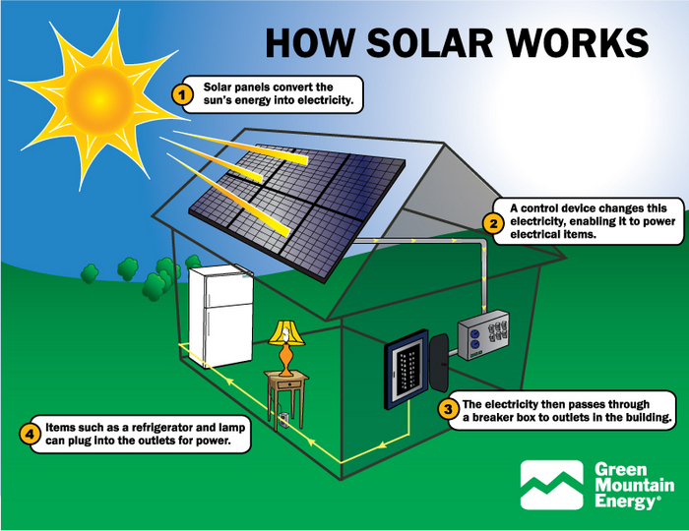
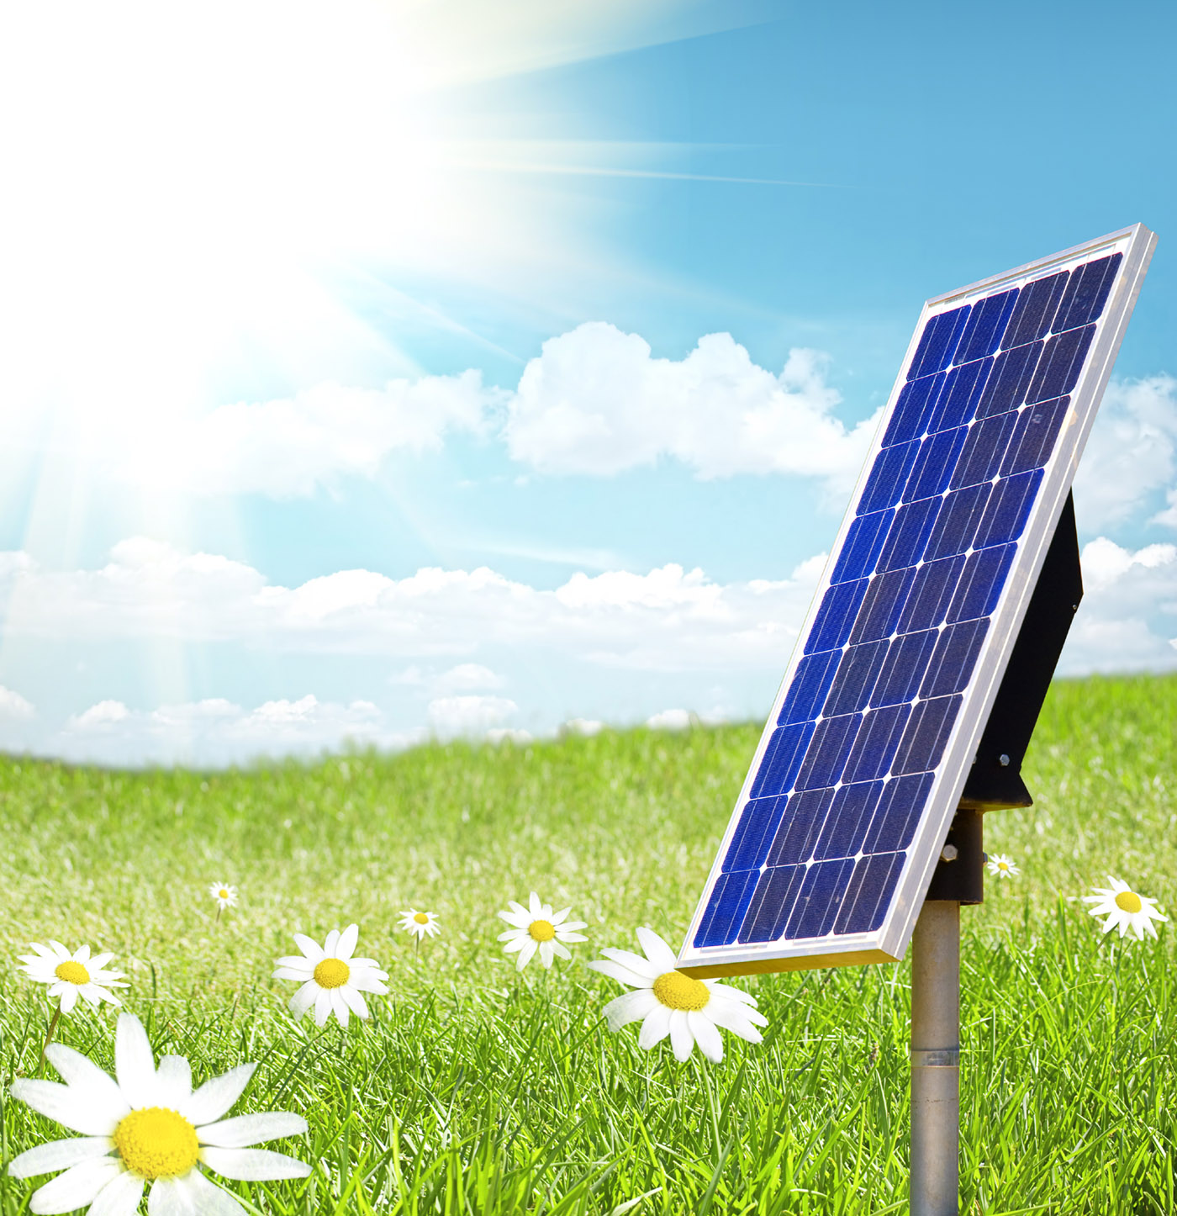
What is the source of your renewable energy?
Solar energy is energy
created from sunlight or
heat from the sun.

Slide 3
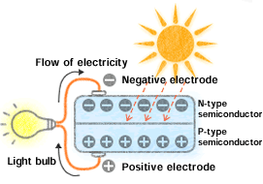
What infrastructure is needed to convert the renewable energy into electrical energy?
Solar panels are needed to convert the renewable energy into electrical energy. There are two types of solar power generating systems: grid-connected systems, which are connected to the commercial power infrastructure. Or stand-alone systems, which send electricity to a facility for immediate use, or to a battery for storage.

Slide 4
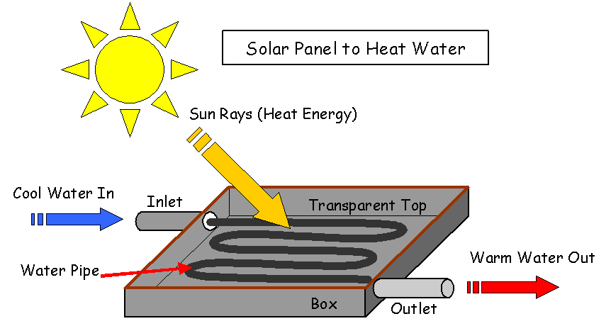
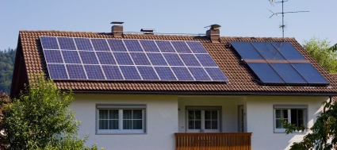
What is the cost of building such infrastructure?
A medium sized system that includes 24 solar panels that generates about 815 kWh a month would cost about $10,500.

Slide 5
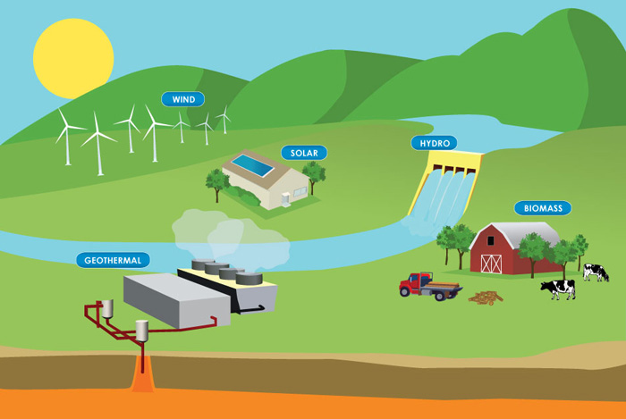
Energy Efficiency
ENERGY TYPE | SOURCE | ENERGY EFFICIENCY
Renewable | Solar | 15%
Non-renewable | Coal | 80%

Slide 6
Energy transfers and transformation
Solar: Light Energy > Electrical Energy > Mechanical Energy > Kinetic Energy
Sunlight hits the solar panel and transforms the light energy into electrical energy.
The electrical energy (electricity) passes through the wire to the motor.
The motor transforms the electrical energy into mechanical energy to turn the driveshaft which turns the wheels.
The wheels rotate on the ground to move the vehicle transforming mechanical energy into vehicle motion (kinetic energy).
Coal: Coal is pulverized into a fine powder, and mixed with hot air.
The combination is transferred to a furnace, and heats a boiler containing water to create steam. Steam turns a turbine engine, transforming heat energy from burning coal into mechanical energy.
The spinning turbine powers a generator, which transforms the mechanical energy into electric energy.
A condenser cools the steam, turning it back into water that returns to the boiler

Slide 7
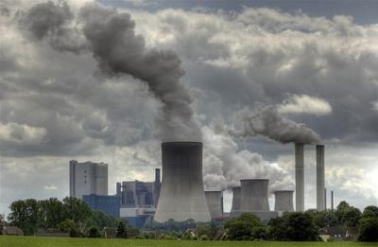
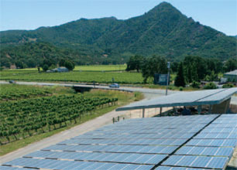
Environmental effect
Solar: The potential environmental impacts associated with solar power are land use and habitat loss, water use, and the use of hazardous materials in manufacturing.
Coal: Air pollution from coal-fired power plants includes sulfur dioxide, nitrogen oxides, particulate matter, and heavy metals, leading to smog, acid rain, toxins in the environment, and numerous respiratory, cardiovascular, and cerebrovascular effects.

Slide 8
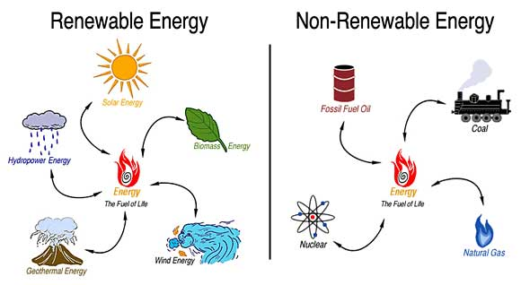
Bibliography
www.aie.org.au
www.makeitsolar.com
www.edfenergy.com
futuresparks.org.au
www.peabodyenergy.com
global.kyocera.com

